Slide 1
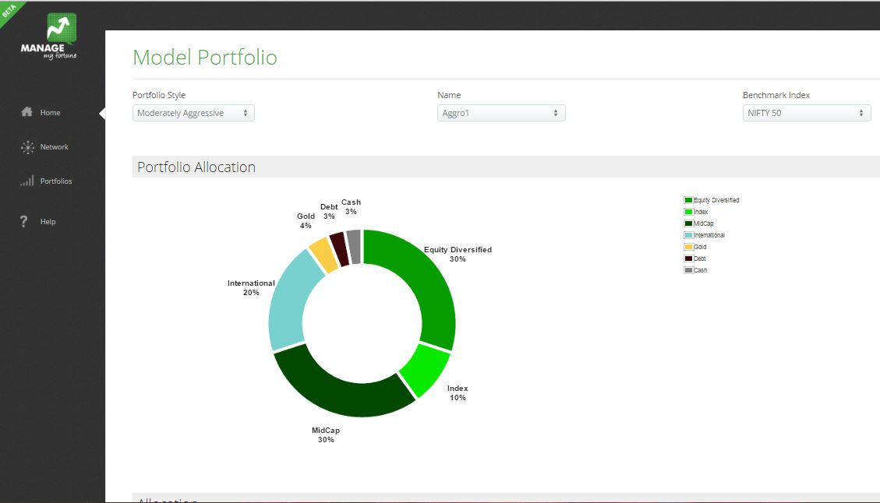
PORTFOLIO DISCUSSION – 6/4/2016
This discussion was for the Advisor Side – creating or editing portfolios
In create/edit portfolio we already have something called “Portfolio Style”
Conservative
Moderately Conservative
Moderate
Moderately Aggressive
Aggressive

Slide 2
PORTFOLIO DISCUSSION – 6/4/2016
Introduction of a new feature/category – “Portfolio Size”
“Portfolio Size” will have the following items in the drop-down list
Lump-sum 10,000 min
Lump-sum 50,000 min
Lump-sum 1,00,000 min
SIP 1,000 min
SIP 5,000 min
SIP 10,000 min
SIP 20,000 min

Slide 3
Portfolio Size

Slide 4
PORTFOLIO DISCUSSION – 6/4/2016
Another important issue is tackling the Min. Subscription Price for Mutual Funds
Logic thought of:
Min. Acquisition cost for security = Max(CMP/NAV, Min Subscription for MF’s)
Proportionate Portfolio value = Allocation% x Portfolio Size
(Value given to each security)
No. of units = Floor(Proportionate Portfolio value / CMPorNAV)
Transaction eligibility = Floor(Proportionate Portfolio value / Min. Acquisition cost )
If(Transaction eligibility > 0)
Then, its OK or an immediate error message displayed to change security or increase allocation

Slide 5
PORTFOLIO DISCUSSION – 25/4/2016 (New Changes)
Logic thought of:
Transaction eligibility = (Proportionate Portfolio value / Min. Acquisition cost )
If(Transaction eligibility > 1.2)
Then, its Ok to trade and we give a green signal
If(Transaction eligibility >= 1 && Transaction eligibility < 1.2)
Then, its Ok to trade but there might be a rebalance due to price fluctutaions and we give a orange signal
If(Transaction eligibility < 1)
Then, trade cannot go through and we give a red signal, and the advisor is asked to increase security allocation or change security

Slide 6
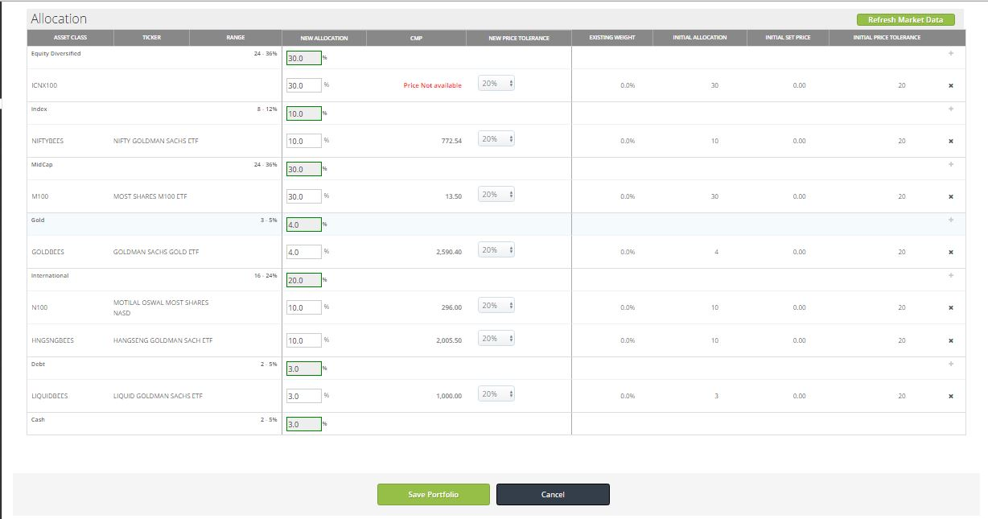
Price Tolerance Columns we will be hiding

Slide 7
Rename TICKER to SECURITY
Remove this and introduce “Minimum Investment”
Remove this
Points to note:
Merge 1st and 2nd column and name it ASSET CLASS / SECURITY
Keep Range as a separate column. Currently its merged with TICKER column as contents of TICKER column enter Range column. Keep range as separate and center align its contents.
Remove display of TICKER and start security name display from where TICKER is displayed now

Slide 8
PORTFOLIO DISCUSSION – 6/4/2016
Two new columns will be added to the table
“Min. Acquisition Cost” – displaying the max of min. subscription for MFs and CMP/NAV
“Proportionate value” – displaying the amount allocated to that security/asset class
Another feature thought of:
Introduce “Price Target” and “Stop Loss” for each securities instead of “Price Tolerance”

Slide 9
PORTFOLIO DISCUSSION – 25/4/2016
The rebalance trigger needs to be generated when the Transaction eligibility falls below 1
This check needs to be done for each security

